Slide 1

TRIBHUVAN UNIVERSITY
Faculty of humanities and social science
Ratna Rajya Laxmi Campus
Exhibition Road, Kathmandu
“E- Learning System (Hamro Siksha)”
Submitted by
Krishna Prasad Bharati (6-2-40-19-2021)
Nabin Dumre (6-2-40-26-2021)
Submitted to
Department of Computer Application
Ratna Rajyalaxmi Campus

Slide 2
Introduction
Hamro Siksha is an online learning platform of the new generation that seeks to change the face of online learning, making high-quality education accessible to all. For students, professionals, and lifelong learners, the platform offers a comprehensive range of courses in multiple fields to design a captivating and fruitful learning experience.
Features:
The System is User-friendly
Hamro Siksha helps learners enhance their skills, acquire new knowledge, and achieve educational

Slide 3
Problem Statement
Learning is outdated since students can only watch and take notes.
The second major issue is the payment process
Hamro Siksha addresses such issues by offering a seamless, interactive, and efficient learning platform that enhances user engagement, streamlines certification, and facilitates course access for a better learning experience

Slide 4
Objectives.
The main objectives of the system are-
Enhance Learning Engagement
Offer Timely Certification
Simplify Payment and Access to Courses
Personalized Learning Paths
Increase Accessibility and Flexibility
Create a Supportive Learning Community
Keep Current Course Content

Slide 5
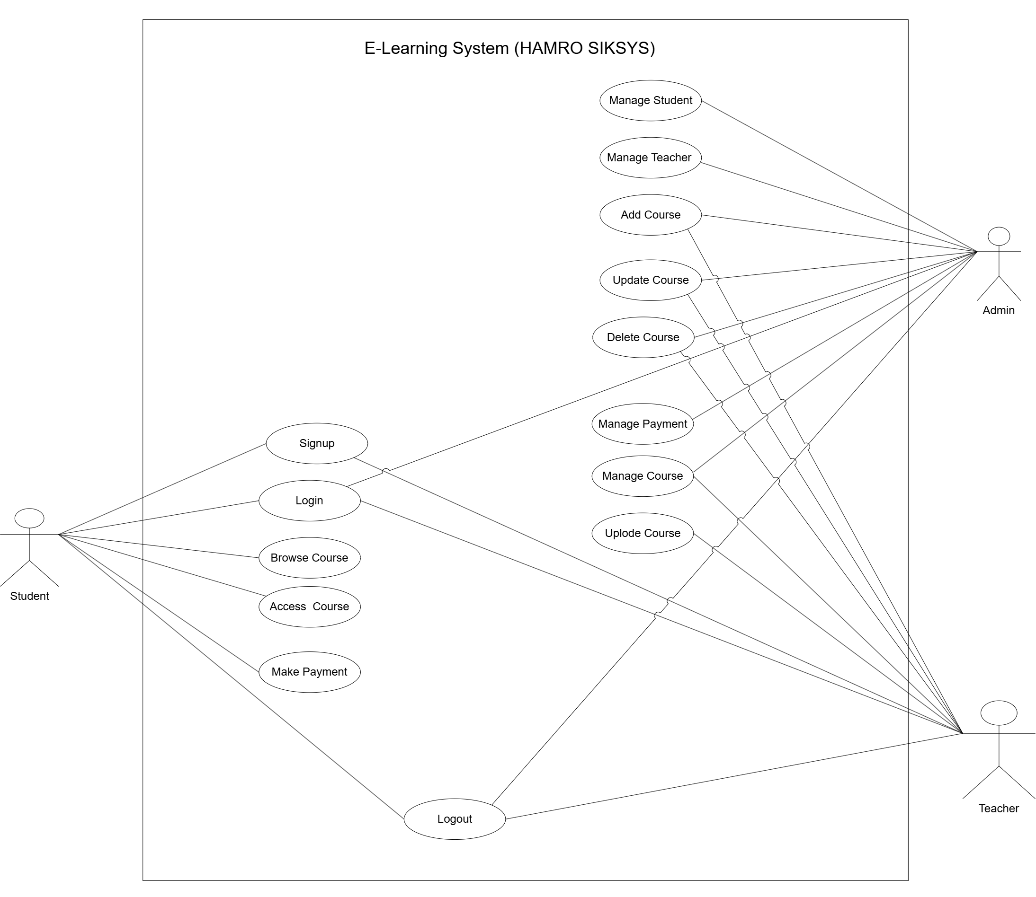
Use case Diagram

Slide 6
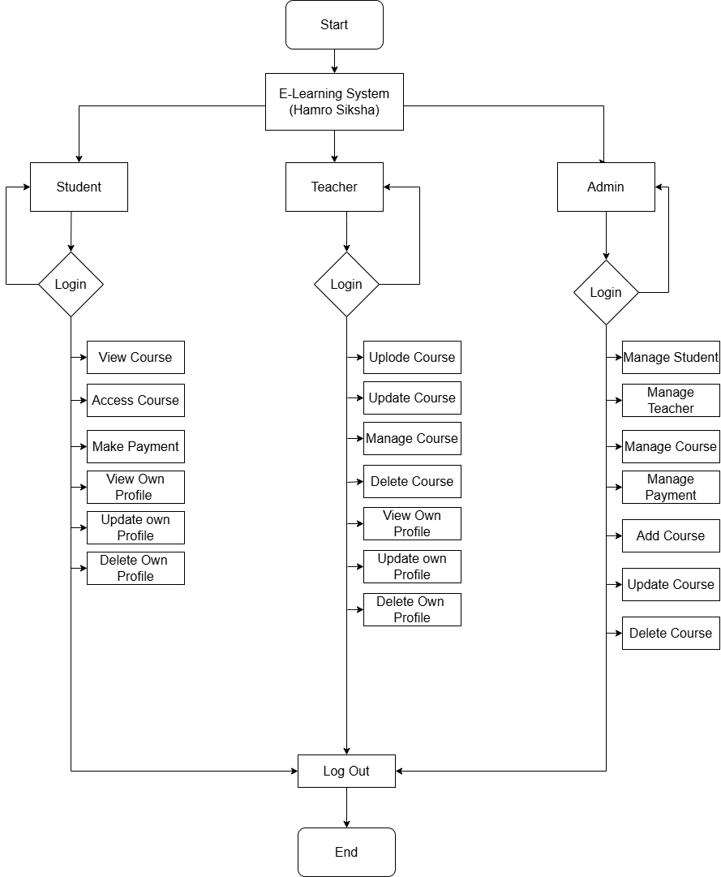
System Flow chart.

Slide 7
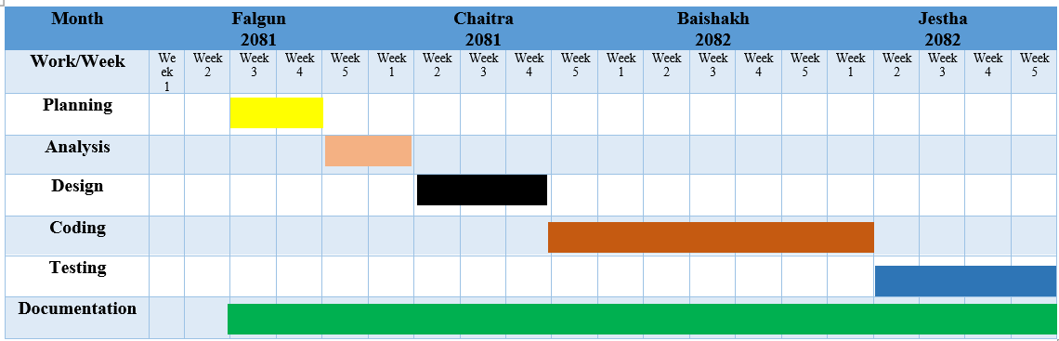
Gantt Chart.

Slide 8
EXPECTED OUTCOME
Enhanced User Engagement
Timely Certification
Improved Accessibility and Convenience
Personalized Learning Experience
Community Collaboration and Support
Continuous Learning and Skill Development

Slide 9
References
https://www.edutopia.org/online-learning-guide
https://www.elearningindustry.com/
https://app.diagrams.net/

